Slide 1
Sierra Leone Maternal & Child Health Analysis
Luddy School of Informatics, Computing, and Engineering
GROUP 3
Bekezela Kusina, Kruthika Gaddam, Megha Moncy, Sahiti Somalraju, Shikhar Shukla
INFO B585 Biomedical Analytics
Instructor- Dr. Saptarshi Purkayastha

Slide 2

SIERRA LEONE
Sierra Leone, located in West Africa with
Freetown as its capital, has a population
of 8.421 million (2021). It ranks 18th globally
in maternal mortality and 5th in infant mortality, according to the CIA.

Slide 3
Question 1: Review the trendline between ANC IPT 1 coverage and ANC IPT 2 coverage for all of Sierra Leone for all the months of 2022 and the first 6 months of 2023 and mention the month in which the trendline met or will meet in the future.
Steps
Data Visualizer App
Data (Series):
Indicators: ANC IPT1 Coverage & ANC IPT2 Coverage
Line: Linear Trend line
Period (Category):
Monthly from Jan 2022 to June 2023
Org Units (Filter):
Sierra Leone
Plot: Line Graph
Notes:
Insert a picture of one of the geographic features of your country.

Slide 4
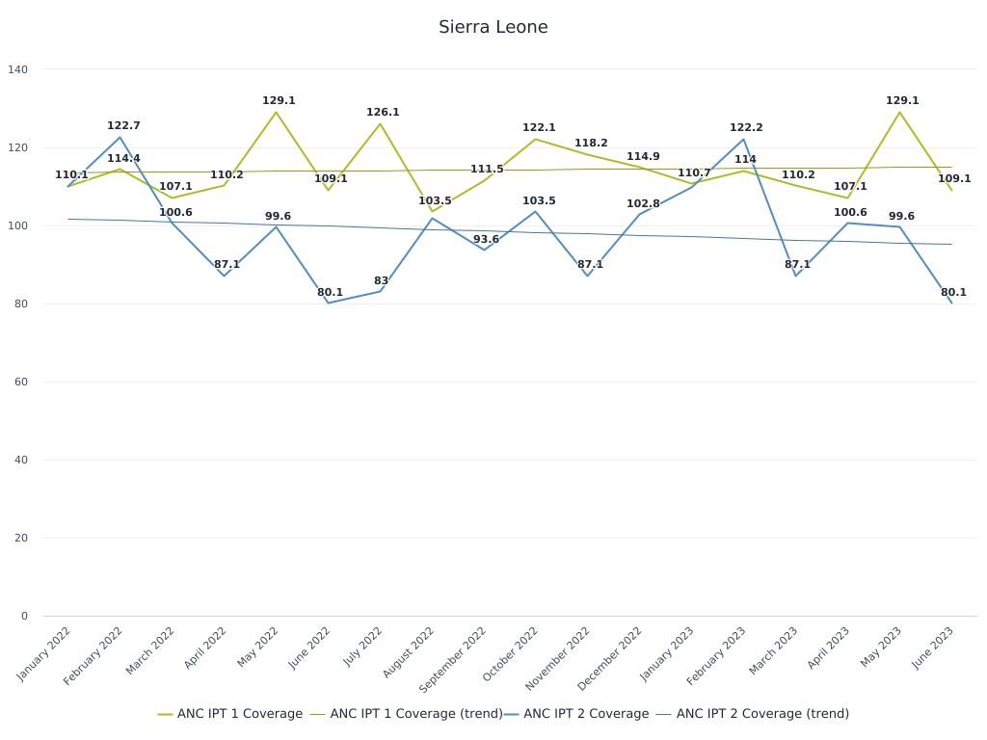
Q1: Results
Analysis:
Trend lines derived from monthly coverage data indicate the overall direction of each treatment's uptake.
ANC IPT 1: slight fluctuations with a general maintenance of coverage levels.
ANC IPT 2: more variable pattern, suggesting inconsistent coverage over the same period.
Key Observation:
The trend lines for ANC IPT 1 and ANC IPT 2 coverage do not converge within the given timeframe.
There is no month where the coverage rates trends for the first and second dose of IPT are equal or cross over.
Implications:
The absence of an intersection points to persistent differences in the uptake rates between the first and second IPT doses.
Notes:
Insert a picture of one of the geographic features of your country.

Slide 5
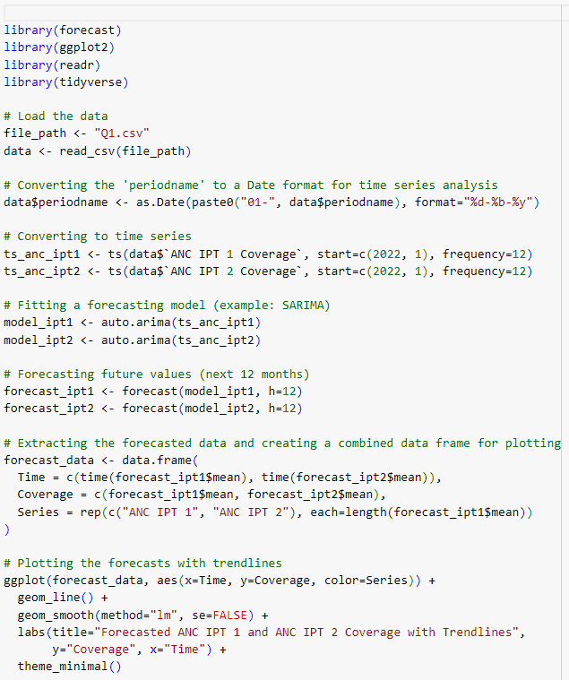
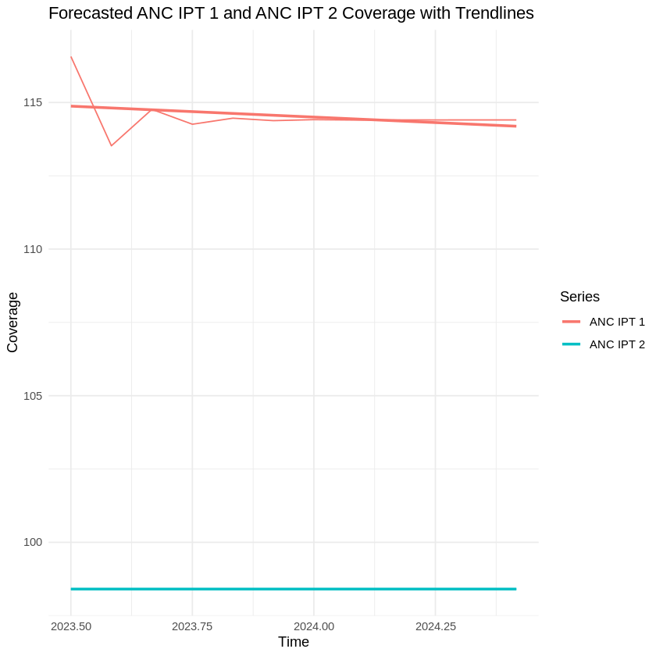
Q1: Forecasting and Trend Analysis
Forecasting Approach:
Applied Auto-Regressive Integrated Moving Average (ARIMA) models to capture the time series characteristics of the data.
Conducted a 12-month forecast to determine future trends and the potential meeting point of coverage rates.
Visualization and Trend Analysis:
Employed ggplot2 to create comprehensive visualizations, illustrating both actual and forecasted coverage data with trendlines.
The trendlines were calculated using linear regression to highlight the overall direction of the coverage rates over time.
Conclusion:
The current trajectory indicates a widening gap between the first and second ANC IPT coverage.
Public health officials may utilize these insights to formulate policies aimed at narrowing the coverage disparity.
Notes:
Insert a picture of one of the geographic features of your country.

Slide 6
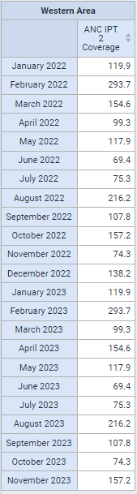
Question 2: Using SES method, forecast the ANC IPT 2 coverage for the month of Dec 2023 for the Western Area district, using data from all the previous months of 2022 and 2023. (with 2 of your own choices of alpha). Check the error for the last 6 months.
Steps
Data Visualizer App
Data (Columns):
Indicators: ANC IPT2 Coverage
Period (Category):
Monthly from Jan 2022 to November 2023
Org Units (Filter):
Western Area
Pivot Table
Notes:
Insert a picture illustrating a season in your country.

Slide 7
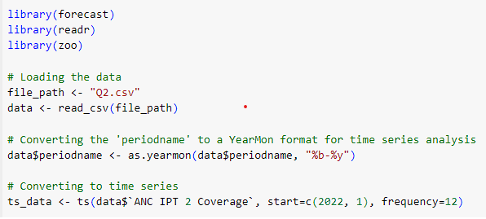
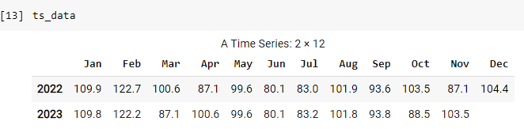
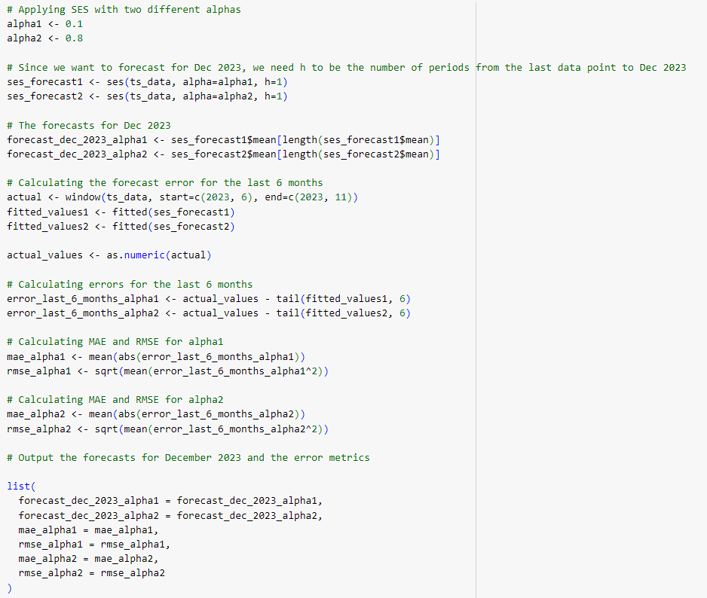
Q2. Forecasting ANC IPT 2 Coverage for December 2023
Forecasting Model:
Simple Exponential Smoothing (SES) was applied to ANC IPT 2 coverage data.
Two models with different smoothing factors (alpha): 0.1 and 0.8.
Forecast Results:
Alpha 0.1 Forecast: 131.20
MAE: 56.23
RMSE: 60.14
Alpha 0.8 Forecast: 142.60
MAE: 67.14
RMSE: 78.38
Analysis:
The model with alpha = 0.1 yields a lower forecast value and demonstrates better accuracy with lower error metrics.
The model with alpha = 0.8 predicts a higher coverage but with greater errors, indicating less reliability.
Conclusion:
The choice of alpha significantly impacts forecast accuracy and the model’s responsiveness to recent changes.
Notes:
Insert a picture of an animal and or plant found in your country.

Slide 8
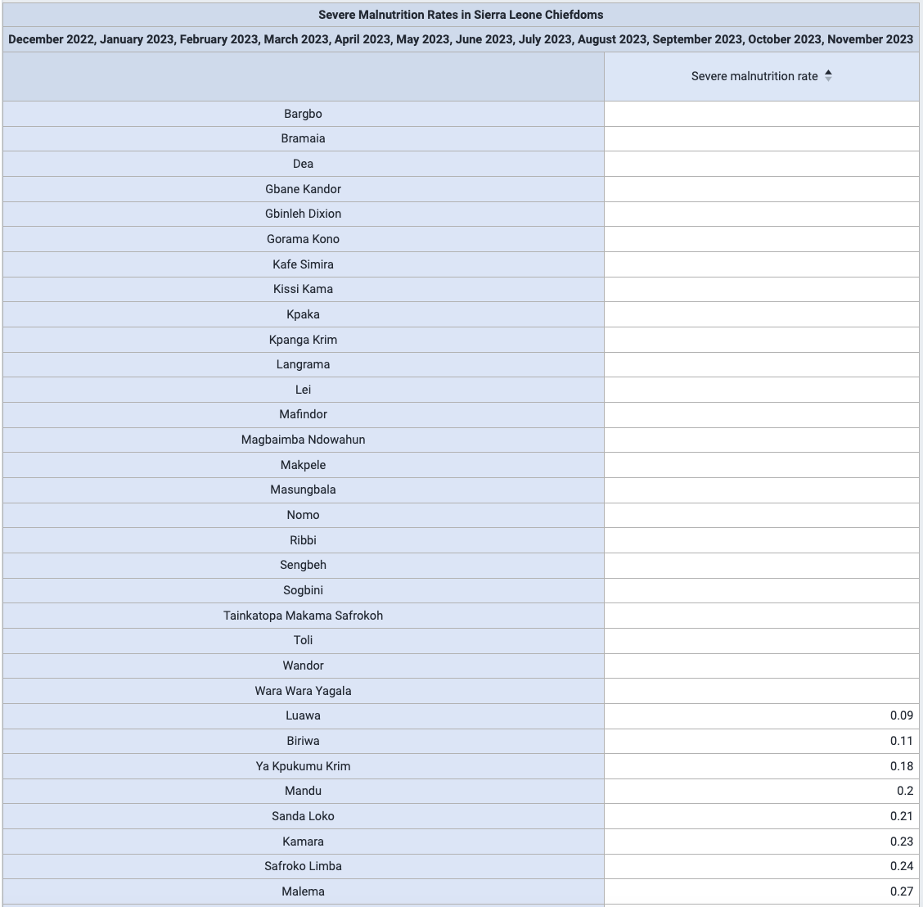
QUESTION 3A: WHERE IS THE CHIEFDOM WITH THE LOWEST MALNUTRITION RATE LOCATED IN THE GEOGRAPHY OF SIERRA LEONE? NAME THE CHIEFDOMS NEAR THE CAPITAL CITY OF SIERRA LEONE WHICH HAVE A HIGH MALNUTRITION RATE. HINT: USE GOOGLE STREETS LAYER TO FIND THE CAPITAL CITY.
Steps
Data Visualizer App
Data (Series):
Indicator: Severe malnutrition rate
Period (Category):
Relative; last 12 months
OrgUnits (Filter):
Level = Chiefdom
Pivot Table
Sort in ascending order
Map
Choropleth
Classes = 9
Display value labels
Bing Road Layer
Measurement tool to approximate distances

Slide 9
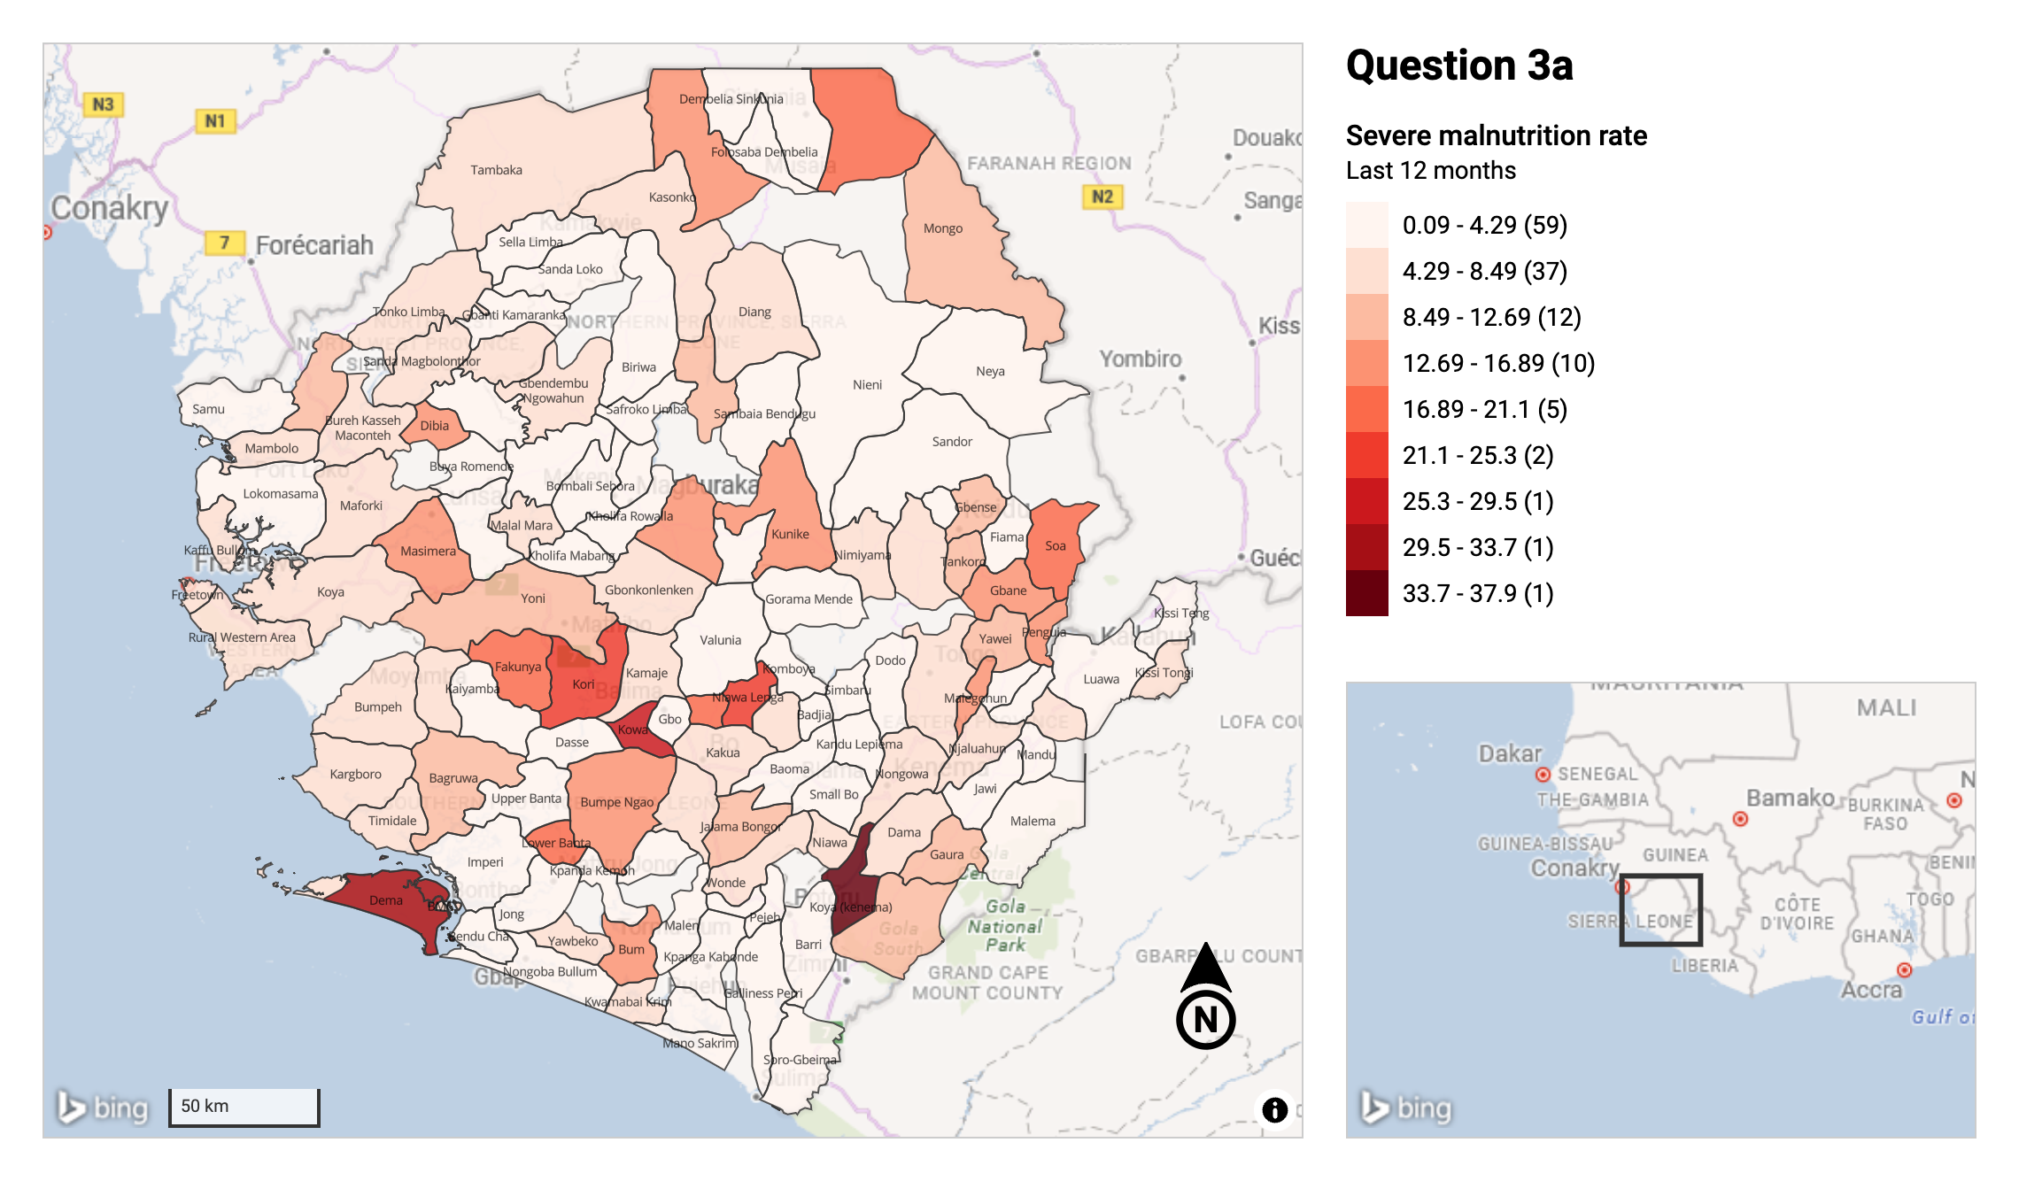
Highest near Free town: considering 75mi radius
Chiefdom | Distance to Capital City
Masimera | 52 miles
Dibia | 58 miles
Faunya | 64 miles
Dema | 72 miles

Slide 10
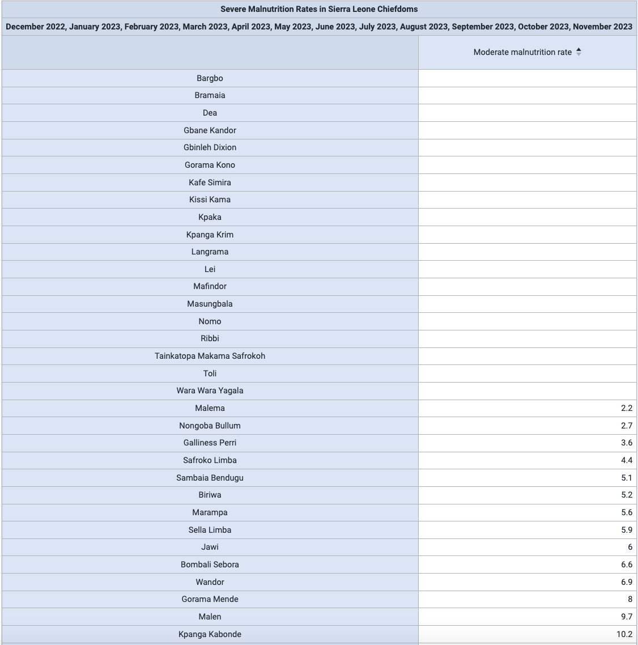
QUESTION 3A: WHERE IS THE CHIEFDOM WITH THE LOWEST MALNUTRITION RATE LOCATED IN THE GEOGRAPHY OF SIERRA LEONE? NAME THE CHIEFDOMS NEAR THE CAPITAL CITY OF SIERRA LEONE WHICH HAVE A HIGH MALNUTRITION RATE. HINT: USE GOOGLE STREETS LAYER TO FIND THE CAPITAL CITY.
Steps
Data Visualizer App
Data (Series):
Indicator: Moderate malnutrition rate
Period (Category):
Relative; last 12 months
OrgUnits (Filter):
Level = Chiefdom
Pivot Table
Sort in ascending order
Map
Choropleth
Classes = 9
Display value labels
Bing Road Layer
Measurement tool to approximate distances

Slide 11
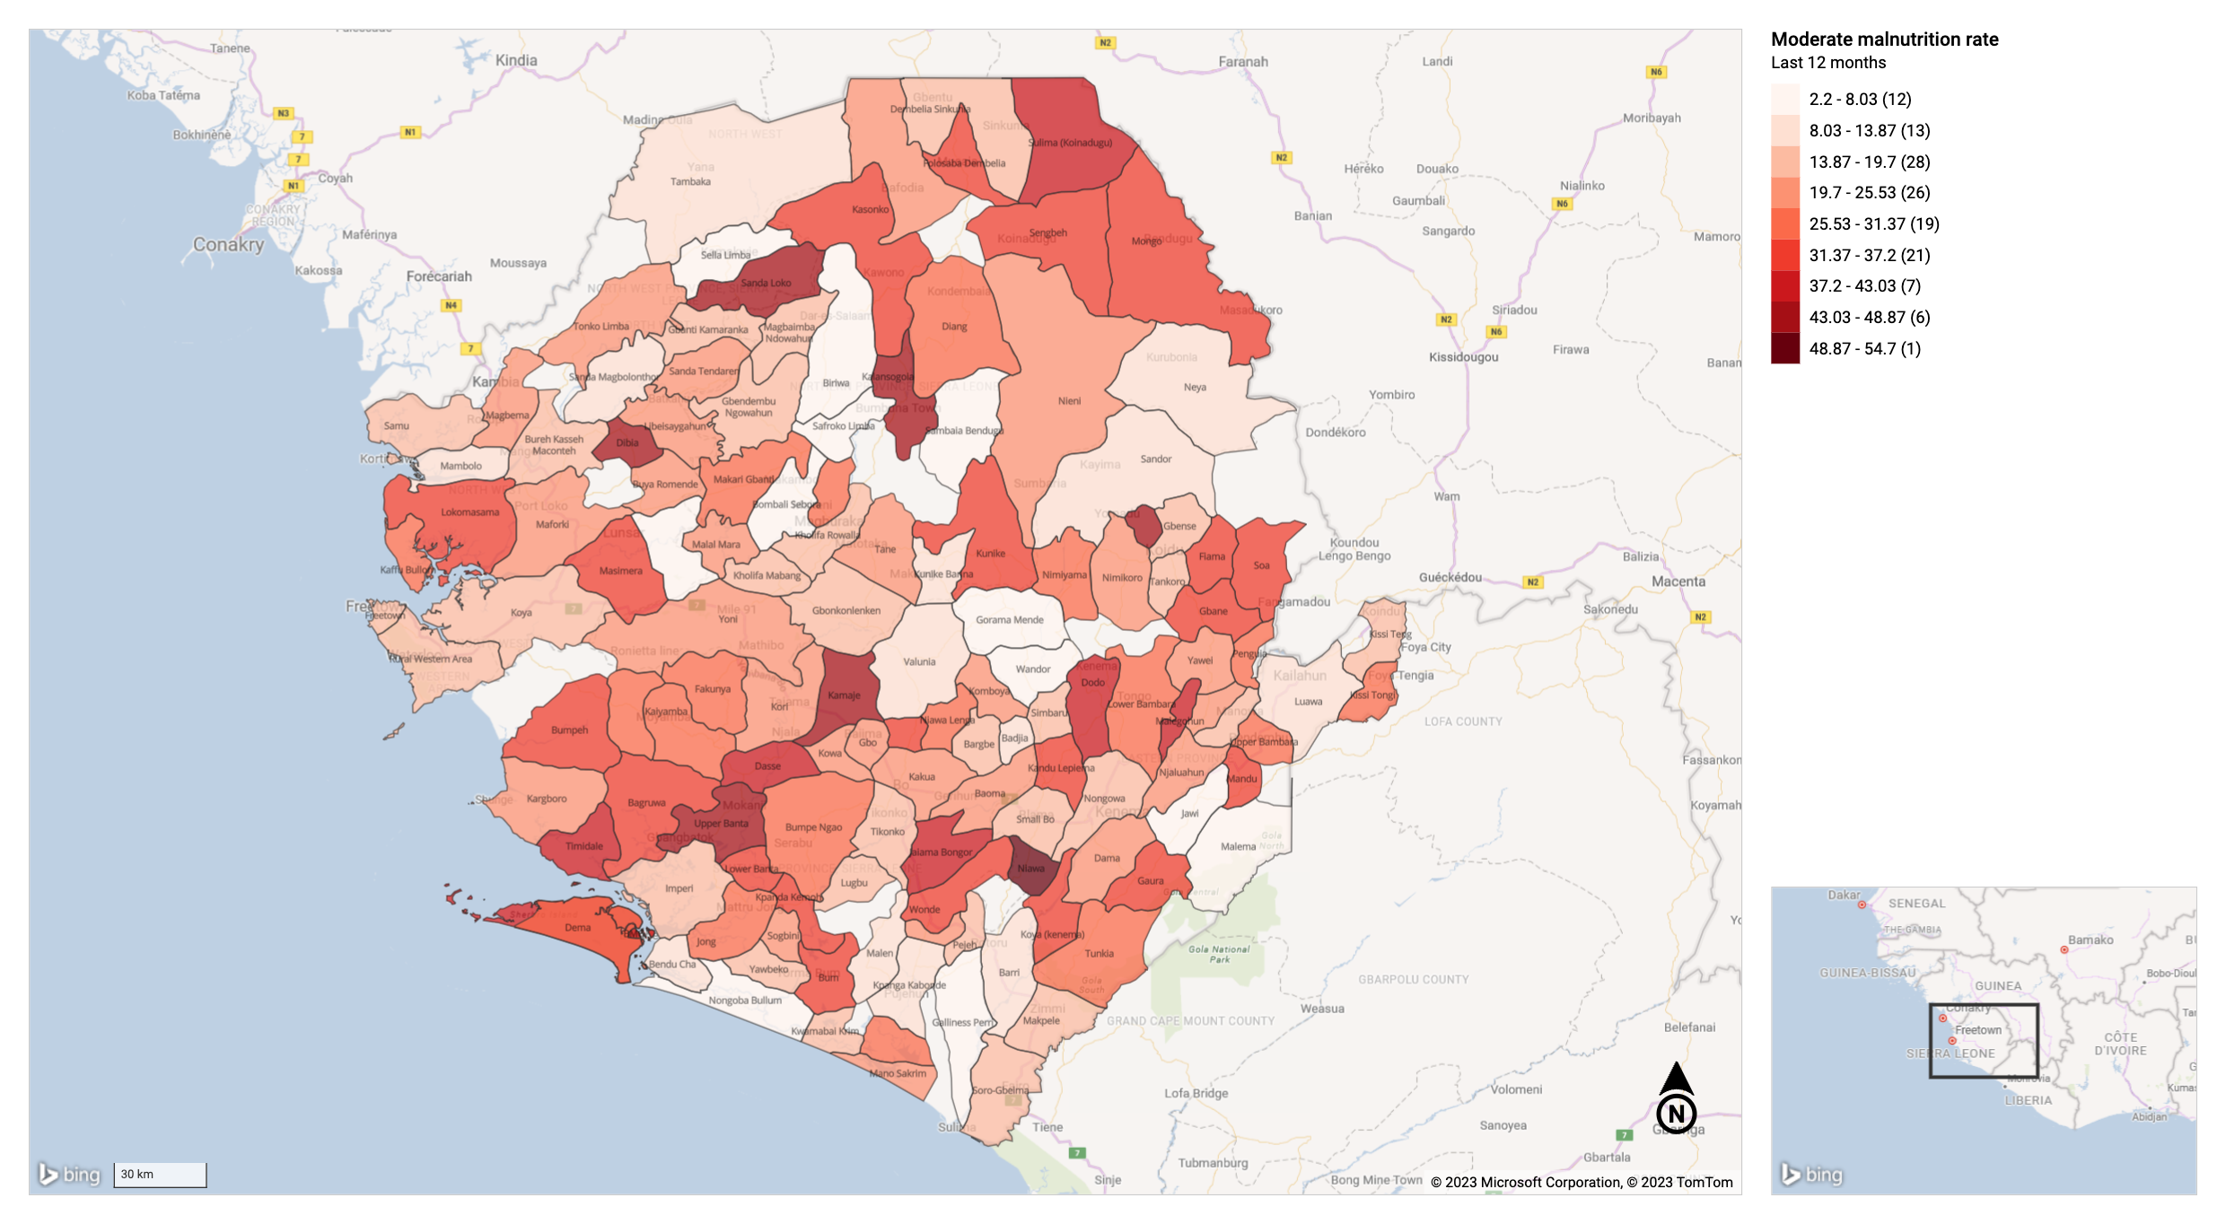
Highest near Free town: considering 75mi radius
Lokomasama- 24 miles
Bumpeh- 40 miles
Bagruwa- 57 miles
Timidale- 59 miles
Dibia- 60 miles
Dema- 64 miles
Masimera- 69 miles
Sittia- 70 miles
Upper Banta- 71 miles

Slide 12
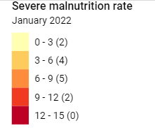
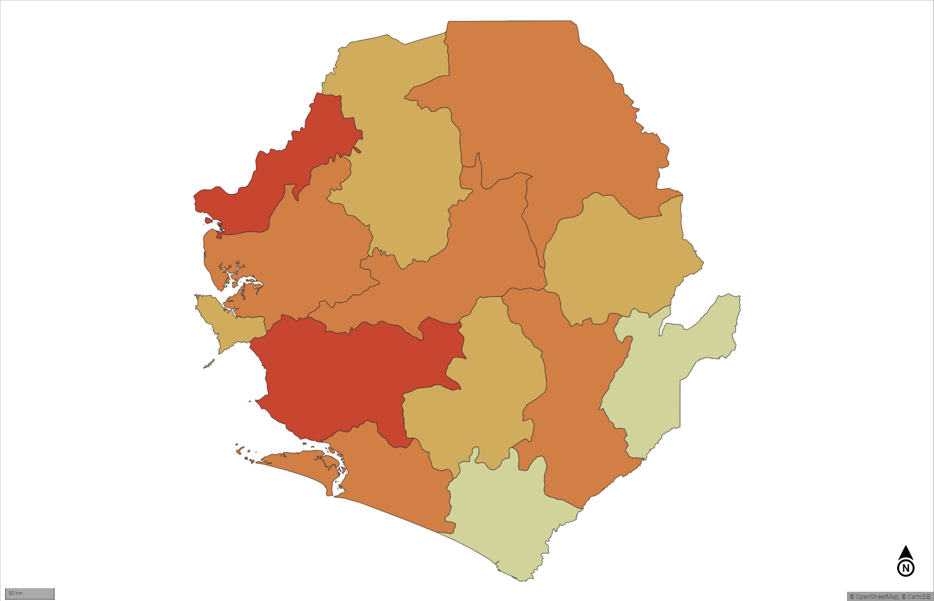
Question 3b: By analyzing the monthly choropleth maps of 2022 and 2023 for severe malnutrition rate by district using a computer vision algorithm, how well can you predict (given the same legend) the severe malnutrition rate of Bo district for November 2023, if all the other districts malnutrition rate is shown on the map.
Steps
Map
Thematic Layer
Data: Item type - Indicator
Indicator Group – Nutrition
Indicator – Severe malnutrition rates
Aggregated by data element
Period: Monthly from Jan 22 to Sept 23
OrgUnits: Sierra Leone
Level = District
Style: Pre-defined color legend
Created a legend that will be fixed for every month
Notes:
Insert a picture illustrating a custom or tradition here.

Slide 13
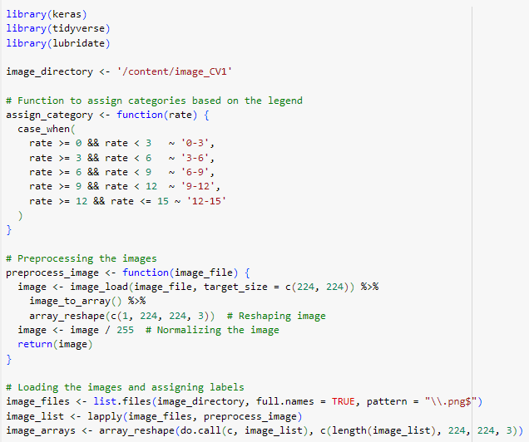
Q3B: Predicting Malnutrition Rates in Bo District Using Deep Learning
Data Source: Choropleth maps representing malnutrition rates across all districts, including Bo, for various months.
Methodology:
Image Preprocessing: Each map image is resized to 224x224 pixels and normalized for consistent input into the neural network.
Category Assignment: Malnutrition rates are categorized into ranges (0-3, 3-6, 6-9, 9-12, 12-15) based on predefined legend criteria.
Model Architecture: Utilization of the Inception ResNet V2 model pre-trained on ImageNet, combined with additional trainable layers for specific task adaptation.

Slide 14
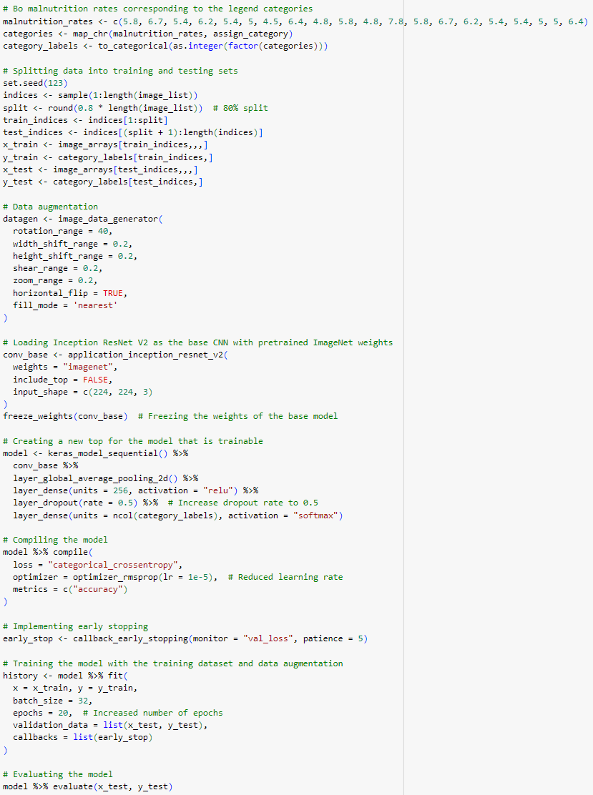
Data Preparation:
Images loaded and preprocessed to extract features (e.g., color intensities and patterns).
Malnutrition rates for the Bo district categorized and converted into one-hot encoded labels.
Training Approach:
Transfer Learning: Leveraging the Inception ResNet V2 model for feature extraction.
Data Augmentation: Applied to increase the diversity of the training data, including rotations and zooms, enhancing model robustness.
Trainable Top Layers: Additional layers added to fine-tune the model on the specific dataset, with a dropout rate of 0.5 to mitigate overfitting.
Early Stopping: Implemented to prevent overtraining, monitoring validation loss with a patience of 5 epochs.
Model Compilation:
Loss Function: Categorical Crossentropy.
Optimizer: RMSprop with a learning rate of 1e-5.
Evaluation Metrics: Accuracy.
Training Execution: The model is trained over 20 epochs with batch size 32, validated against a separate test set.

Slide 15
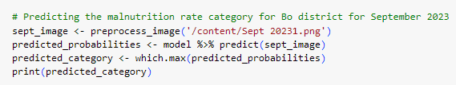
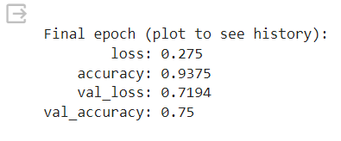
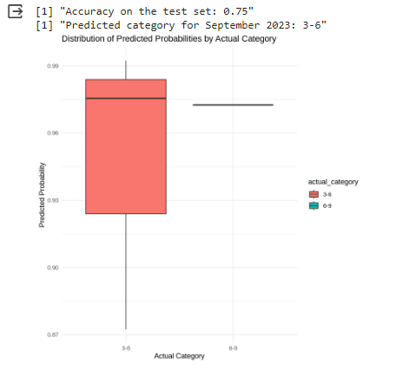
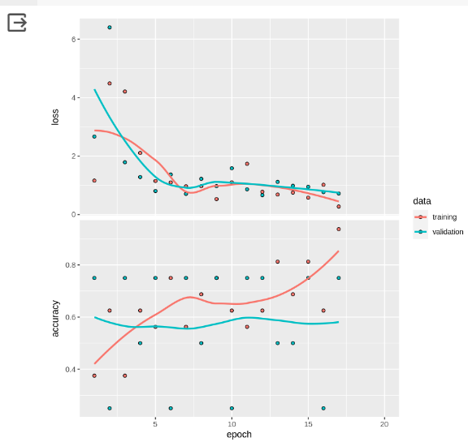

Prediction: Application of the model to predict the malnutrition category for Bo district in September 2023.
Predicted category output [2] ‘3-6’, indicating the model’s accurate assessment of malnutrition severity based on the map's color patterns.
Performance Metrics
Accuracy: 75% - This indicates that the model correctly predicted the malnutrition category for 75% of the test images.
Precision: 75% - Precision measures the accuracy of positive predictions. In this context, when the model predicts a certain category, it is correct 75% of the time.
Recall: 100% - Recall assesses the model's ability to find all relevant instances. Here, it successfully identified all test instances of category ‘3-6'.
F1 Score: 85.71% - The F1 Score is a balance between precision and recall. A higher F1 score indicates better model performance, with 100% being perfect precision and recall.
Implications:
High recall (100%) and F1 score of 85.71%, suggest that the model is very good at identifying the ‘3-6' category.

Slide 16
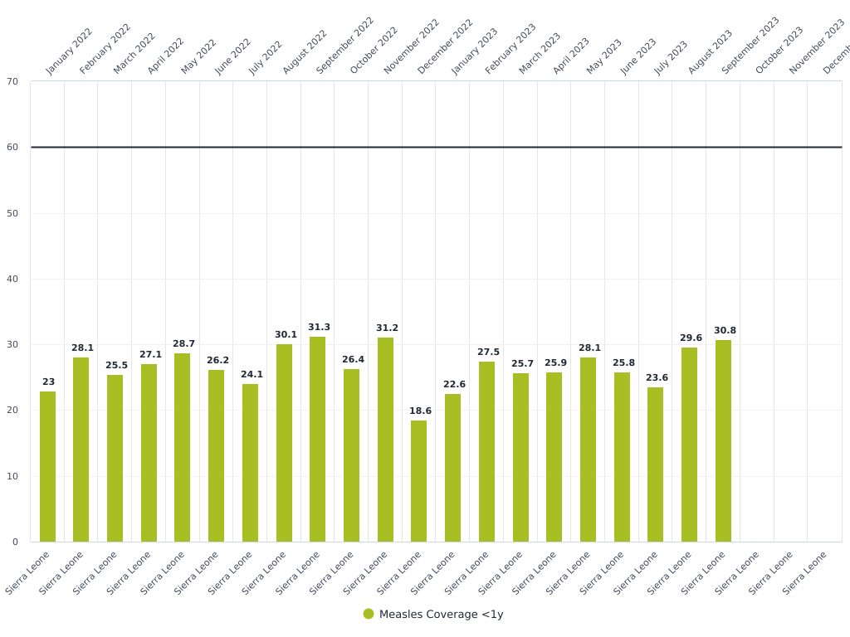
Question 4: Perform a visualization-based analysis of Measles coverage for children less than 1yr in all of Sierra Leone. In this analysis, we also want to see in which months in 2022 and 2023 the coverage target of 60% were missed.
Steps to answer:
Data visualizer app
Data: Indicator: Measles Coverage < 1 year,
Period: 2022 and 2023 monthly data
OrgUnits: all Sierra Leone at National Level
Data is in percent
Target line is set at 60%
Interpretation: If we consider all the Sierra Leone without any level, then it is evident that in all the months, the target of 60% is missed
Notes:
Add key points in the history of your country to the timeline.

Slide 17
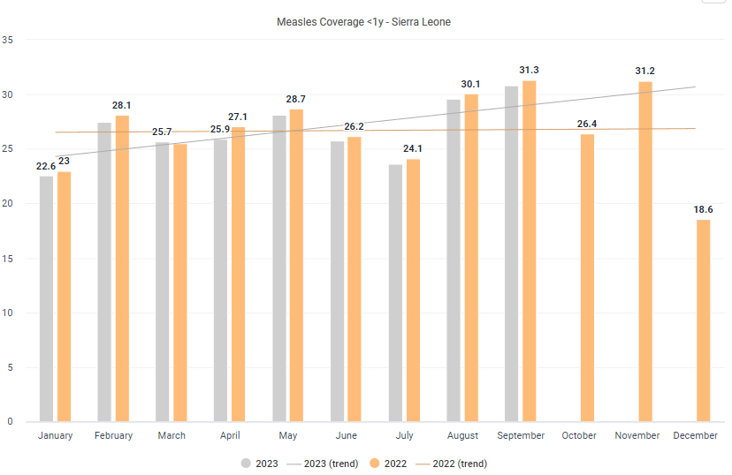
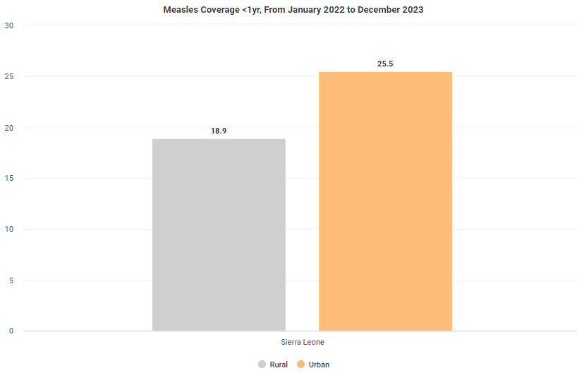
Trend Lines for the Measles Coverage <1yr for all of Sierra Leone
Measles vaccination coverage for children under 1 year exhibited consistent performance in 2022, maintaining a stable trend throughout the year.
In 2023, the trend showed an initial decrease compared to 2022 but improved significantly, exceeding 2022's levels by May. The coverage continued to rise thereafter, suggesting an upward trend. However, the absence of data for October to December 2023 makes it challenging to conclusively determine the trend for the latter part of the year.
Measles Coverage <1yr: Rural vs Urban
The bar graph depicts the measles vaccination coverage for children under 1 year in Sierra Leone, comparing rural and urban areas from January 2022 to December 2023.
The coverage in urban areas (25.5%) significantly surpasses that in rural areas (18.9%), indicating a disparity in vaccination rates between the two regions over the specified period.

Slide 18
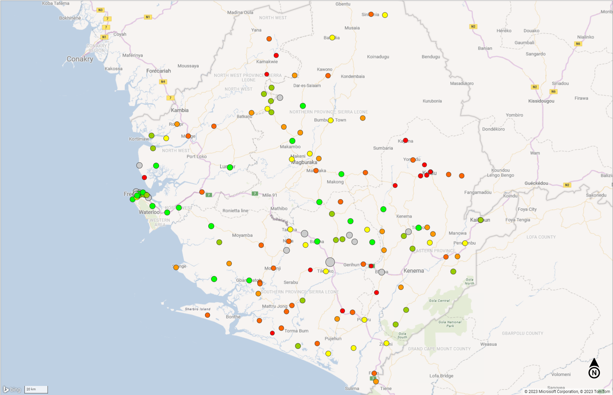
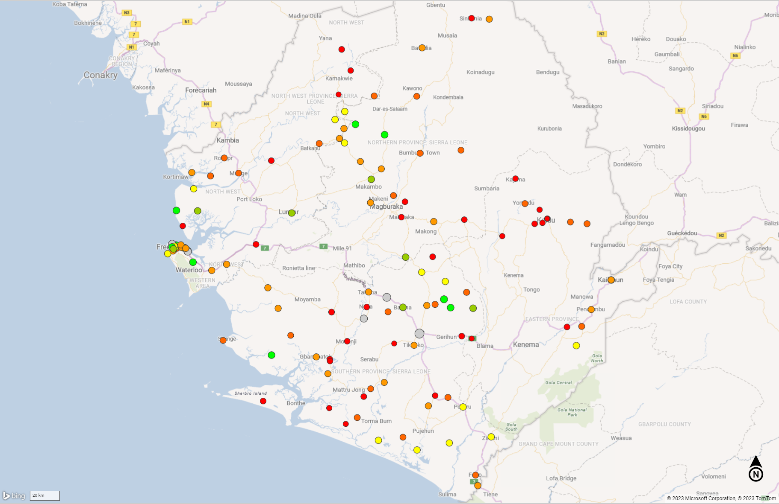
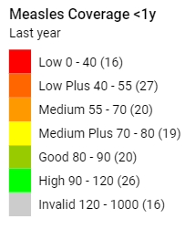
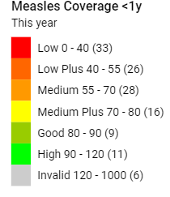
Measles Coverage <1yr at the Facility level for all of Sierra Leone

Slide 19
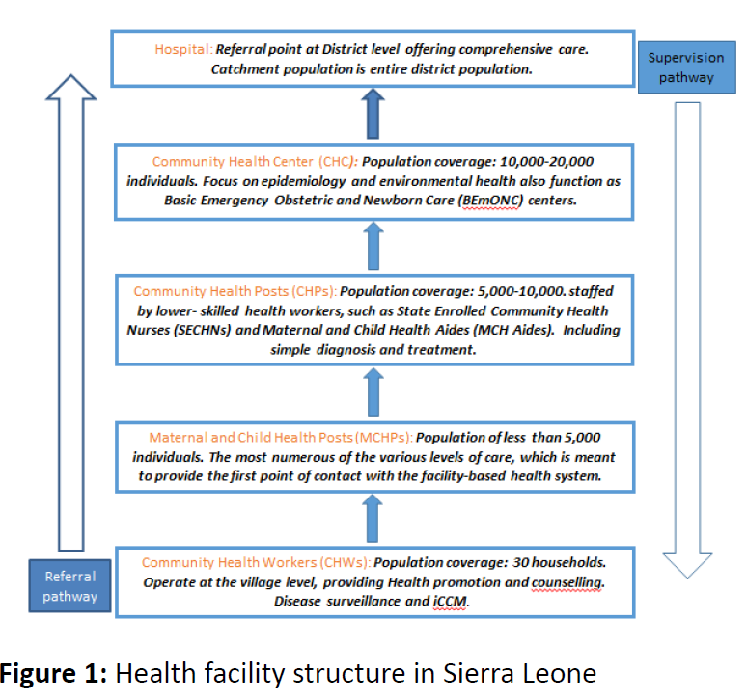
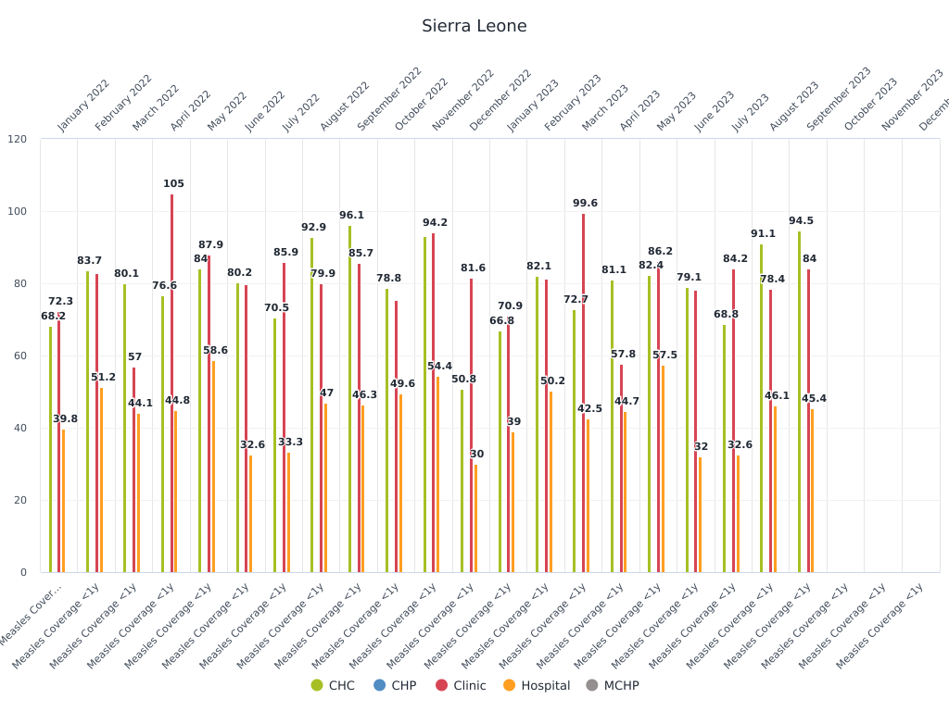
The figure indicates that Maternal and Child Health Posts (MCHPs), which are crucial contact points within Sierra Leone's health system (Babughirana et al., 2018), are not represented in the measles vaccination coverage data for children under one year.
This absence could signify either a lack of data for MCHPs or zero coverage in these facilities, which may contribute to lower overall vaccination rates.
Conversely, Clinics and Community Health Centers (CHCs) exhibit higher measles coverage, suggesting they play a significant role in vaccination efforts.
Health Facility Structure in Sierra Leone - Image courtesy:
Babughirana, Geoffrey & Amponsah, Monica & Banura, Evelyn & Egoeh, Seth & Barrie, Mohammed & Kanwagi, Robert. (2018). Assessment of the Readiness of Community Health Workers to Participate in a Mobile Training and Support Services Innovation: Results of a Functionality Assessment in Bo District, Sierra Leone 2018. American Journal of Computer Science and Information Technology. 06. 10.21767/2349-3917.100028.

Slide 20
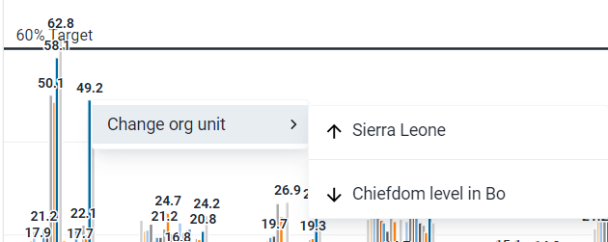
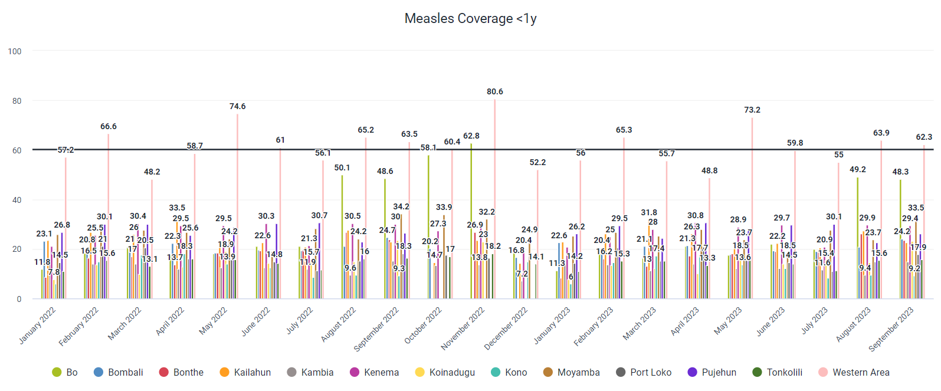
Question 5: Can you drill-down and identify specific districts, chiefdoms, and facilities that missed the target? What are some characteristics of these districts, chiefdoms, and facilities.
Steps to answer:​
Data visualizer app​
Data: Indicator: Measles Coverage < 1 year, ​
Period: 2022 and 2023 monthly data​
Org Units: all Sierra Leone at District Level​
Data is in percent​
Target line is set at 60%
Drilldown by changing org unit

Slide 21
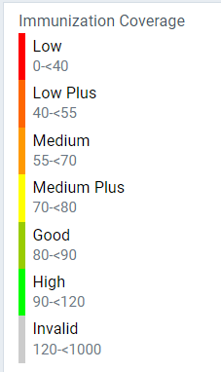
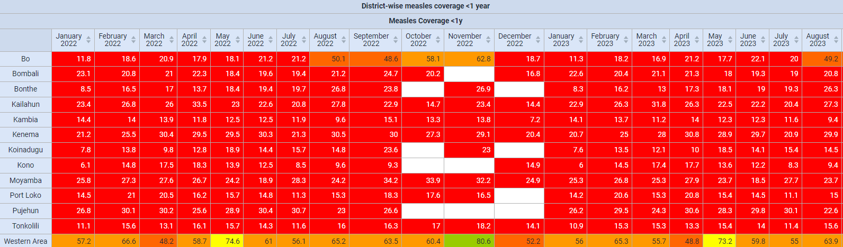
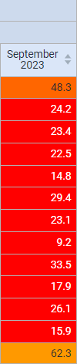
Q5: DISTRICT LEVEL DRILL DOWN WITH 60% TARGET LINE
Majority of Sierra Leone districts missed the 60% measles vaccination target for <1-year-olds consistently for all the months.
Exceptions included specific months in the Western Area district:
Bo achieved 62.8% coverage in November 2022.
Western Area showed promising figures:
February 2022: 66.6%
May 2022: 74.6%
June 2022: 61%
August 2022: 65.2%
October 2022: 60.4%
November 2022: 80.6%
February 2023: 65.3%
May 2023: 73.2%
August 2023: 63.9%
September 2023: 62.3%

Slide 22
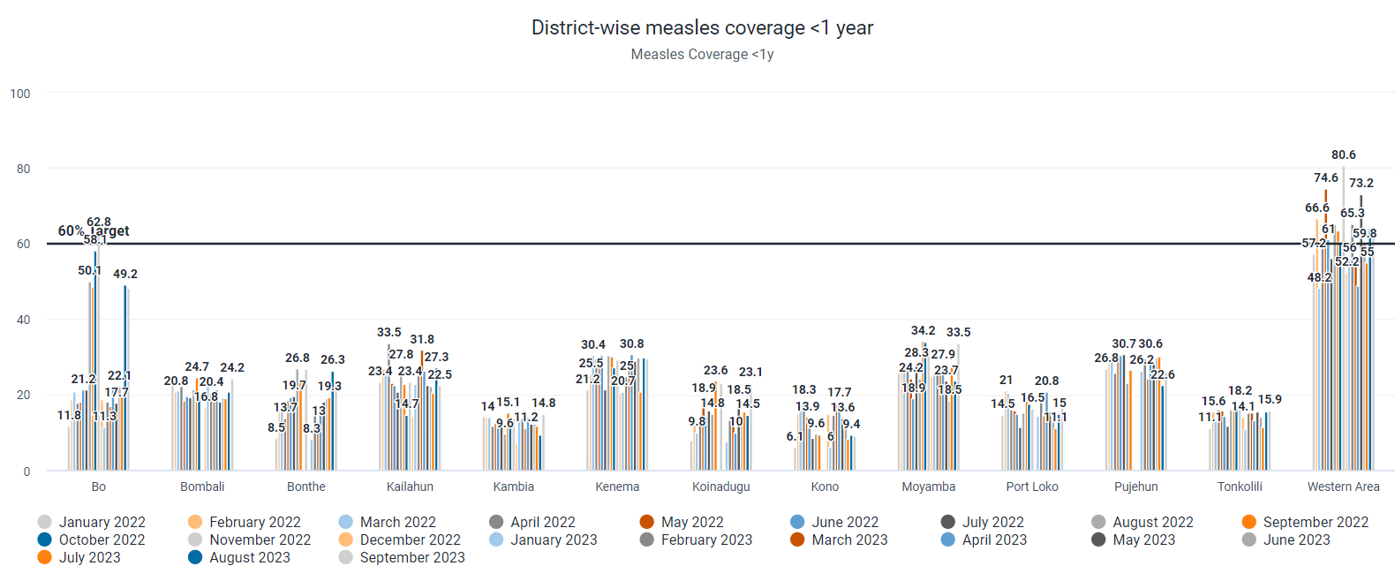
Q5: DISTRICT LEVEL DRILL DOWN WITH 60% TARGET LINE
Only Bo and Western area districts have surpassed the 60% target line at the district level, while the remaining districts fall
below the 60% target line.

Slide 23
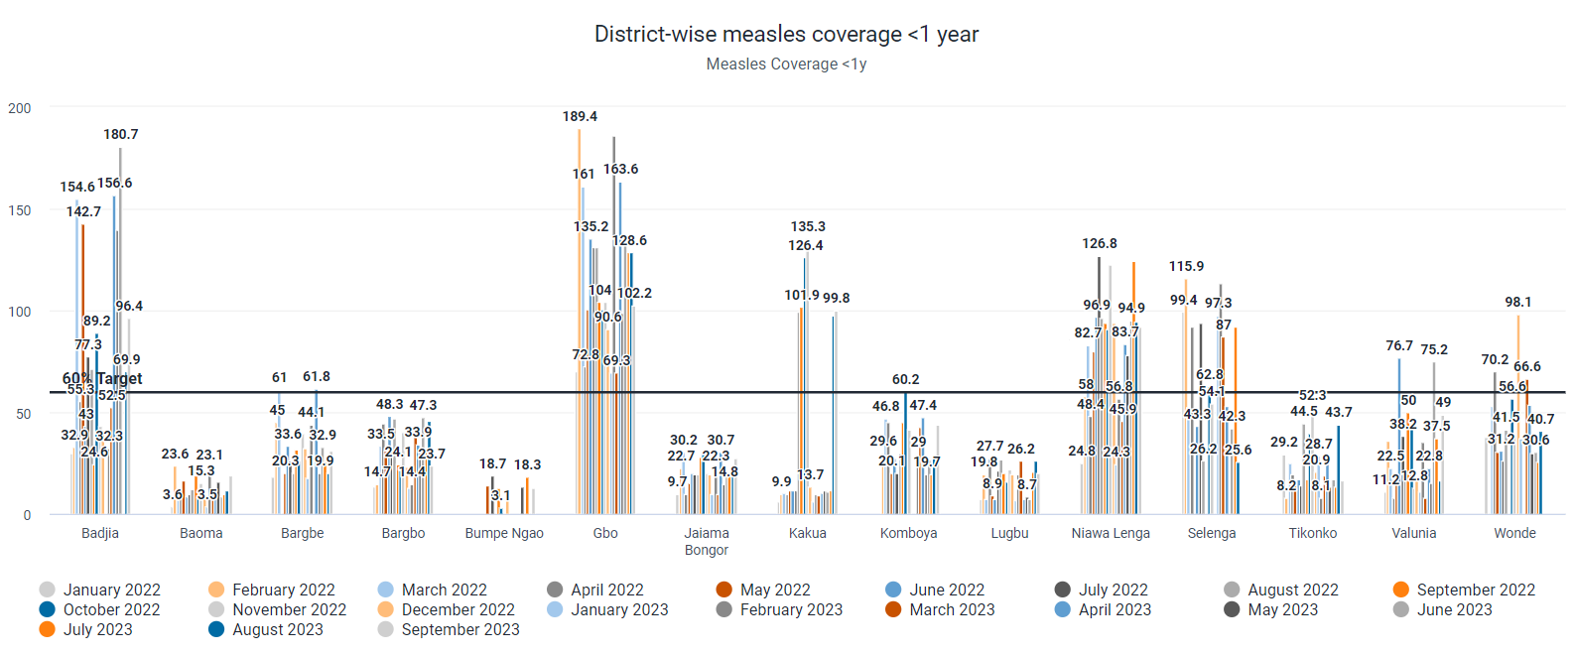
Q5: CHIEFDOM LEVEL DRILL DOWN FOR DISTRICT BO

Slide 24
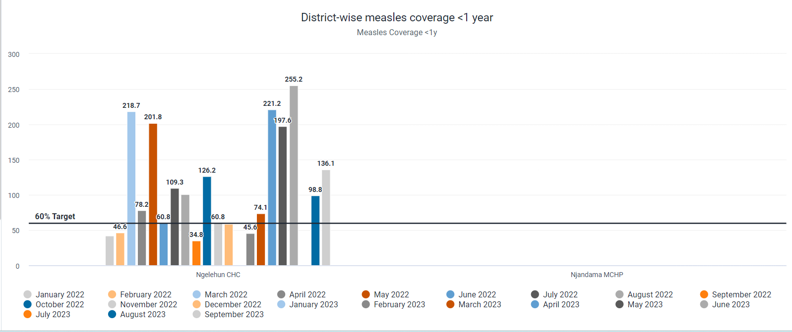
Q5: FACILITY LEVEL DRILL DOWN WITH 60% TARGET LINE of chiefdom BAjda of Bo district
This missing information might mean there isn't enough data from MCHPs or that these places have no
Vaccination coverage, which could lead to lower vaccination rates overall.

Slide 25
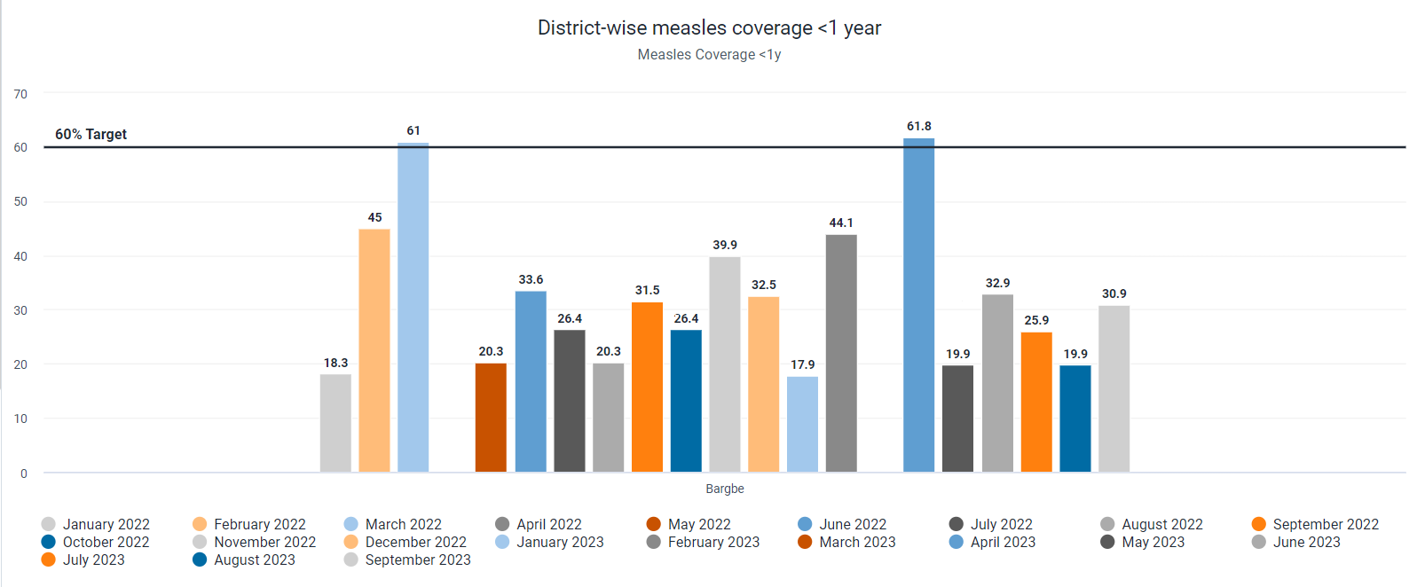
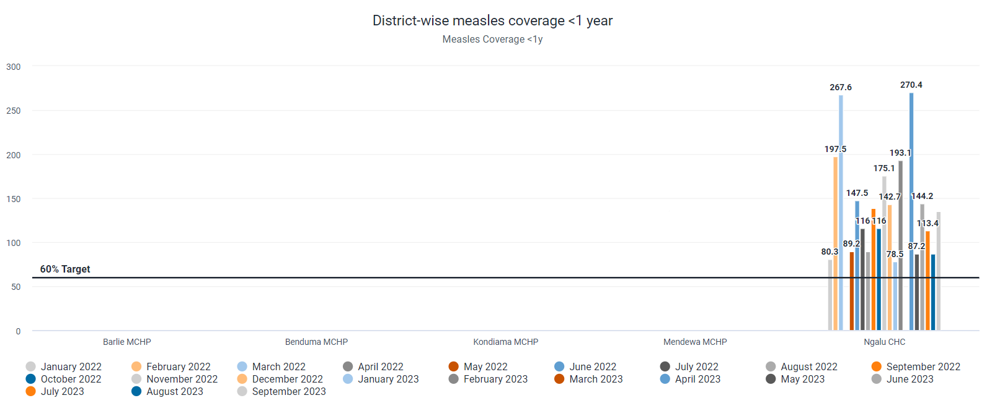
Question 5:
Chiefdom level view
of Bargbe of Bo district
Facility level drill down of Bargbe of Bo district

Slide 26
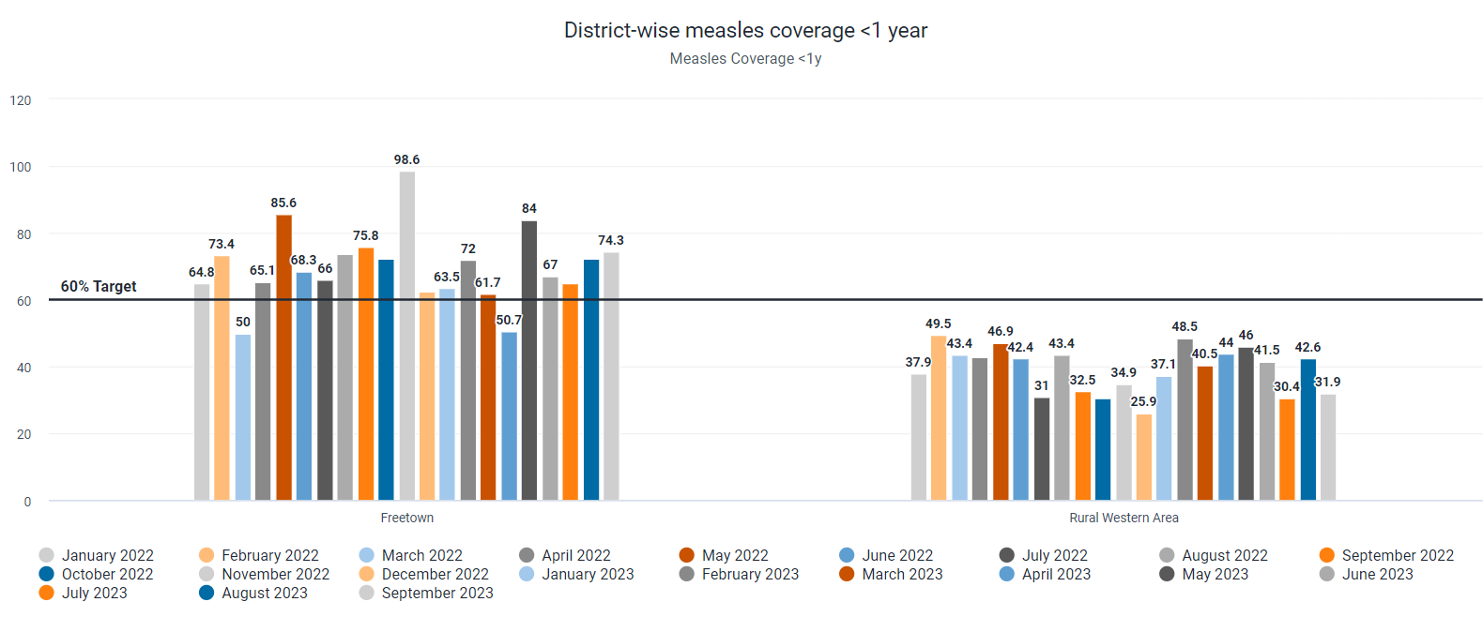
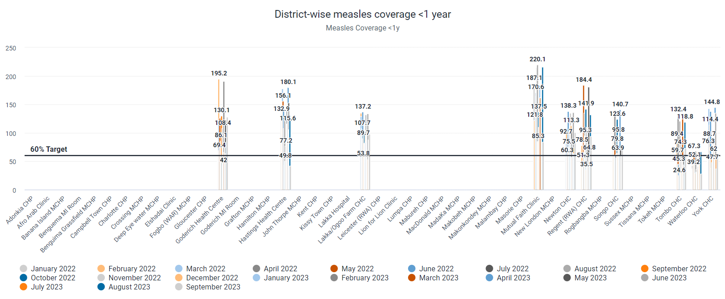
Question 5:
Chiefdom level view
of Western area
Facility level drill down of Rural Western area

Slide 27
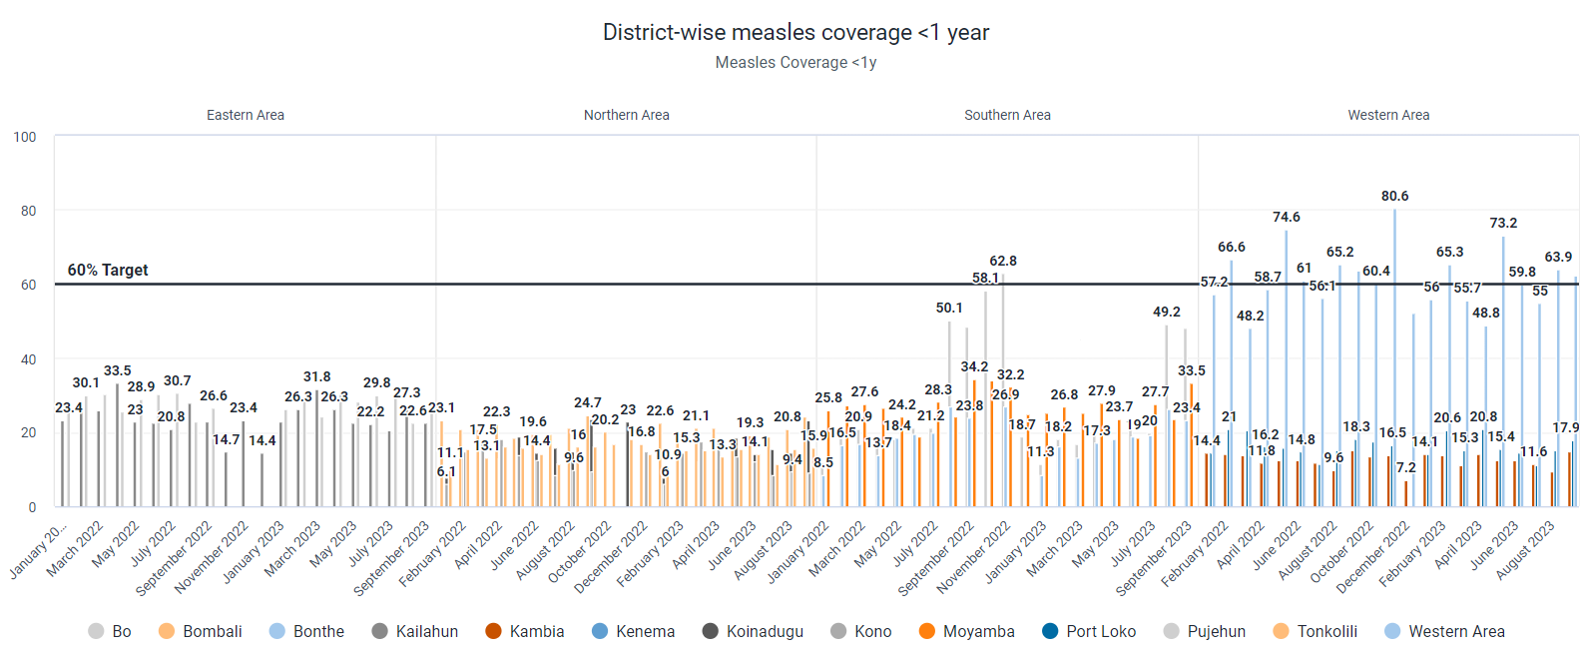
Q5: characteristics of AREAS below Target Line
Dimension: Area- all
Most districts failing to meet the target are from the Northern area, while those successfully reaching the target are predominantly
from the Western area except for Kambia, with a few from the Southern area.

Slide 28
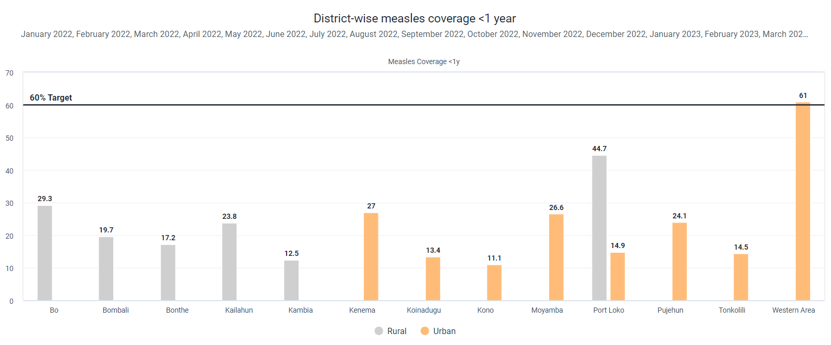
Q5: characteristics AREAS below Target Line
Dimension: Location- rural/urban
The bar graphs for districts either in rural or urban areas show they are the main contributors to vaccination in those districts. Urban areas in Bo, Bombali, Bonthe, Kailahun, Kambia, and Port Loko, along with rural areas in Kenema, Koinadugu, Kono, Moyamba, Pujehun, Tonkolilli, and the Western Area, are the districts failing to reach the 60% vaccination target.

Slide 29
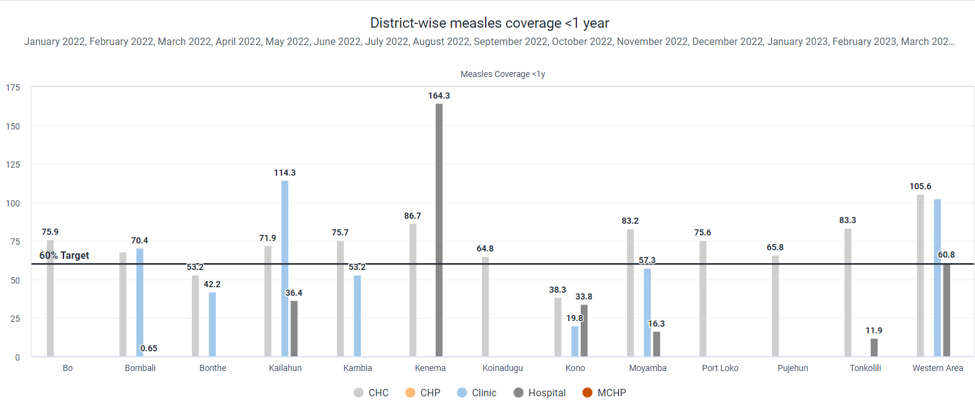
Q5: characteristics of AREAS below Target Line
The missing information might suggest not enough data from MCHPs and CHPs or no vaccinations there due to issues like mobilization, vaccine supplies, or healthcare worker availability, which could lower vaccination rates. However, Clinics and Community Health Centers (CHCs), Hospitals and Clinics have better measles coverage, indicating they're heavily involved in vaccinations.

Slide 30
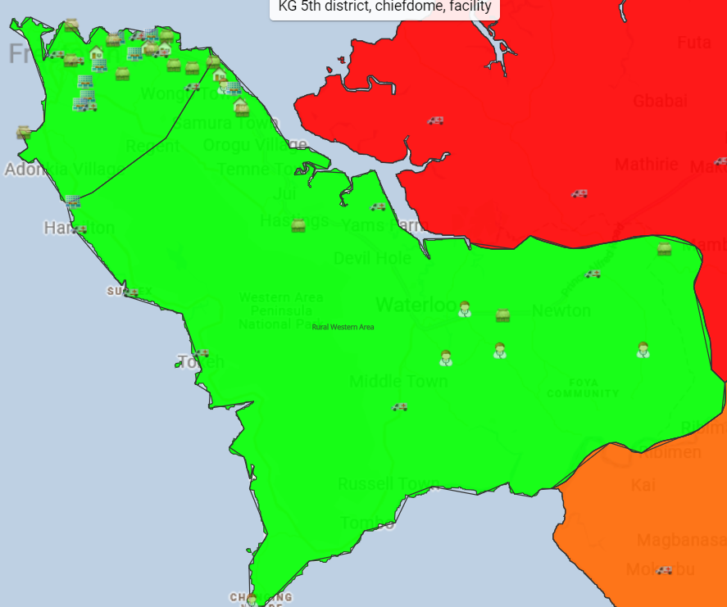
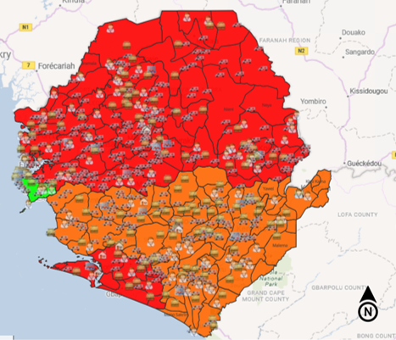
Implications:
Most districts in Sierra Leone are falling short of the 60% target, except for Bo and the Western area.
Although the overall Western area seems to have exceeded the target, only Freetown has crossed this line;
the rural Western area falls below it. This success in Freetown might be due to the effectiveness of clinics, hospitals,
and Community Health Centers (CHCs) compared to other areas. Being the capital, Freetown is more accessible
for mobilization, supplies, and healthcare workers, and it has more facilities than rural areas. To truly understand the
situation, it's crucial to delve deeper into each facility's shortcomings rather than relying solely on general numbers
that might mislead or be misunderstood.

Slide 31
Question 6: Based on the above evaluation, can you describe the type of trend of low measles vaccination coverage? Add the visualization that you think is most appropriate for such analysis on the slides.
Steps to answer the question:
Data Visualizer App
Scatter Plot
Data (Vertical): Measles Doses Given
Data (Horizontal): Measles Coverage <1y
Period (Filter: January 2022-September 2023
Organisation Unit (Points): Sierra Leone
Level: District, Chiefdom, then Facility
Google Colab
Shapiro-Wilk Test for normality
Measles Coverage and Measles Doses Given data was not normally distributed
Spearman's Rank Correlation Rho

Slide 32
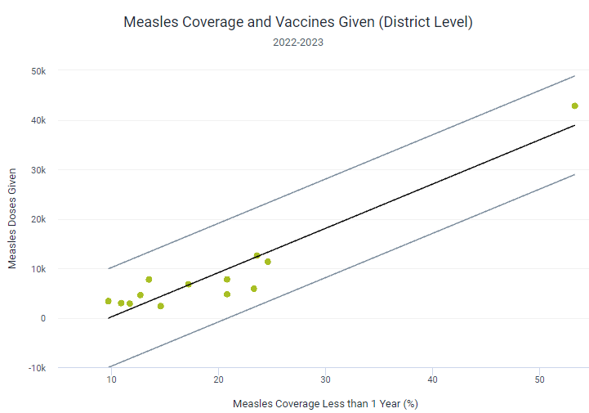
Q6: District Level
Shapiro-Wilks Test:
data: Measles_District$Coverage
W = 0.73675, p-value = 0.001327
data: Measles_District$Doses_Given
W = 0.57852, p-value = 4.298e-05
Spearman's Rank Correlation Rho:
data: Measles_District$Coverage and Measles_District$Doses_Given
S = 73.601, p-value = 0.001083
alternative hypothesis: true rho is not equal to 0 sample estimates: rho 0.7977999

Slide 33
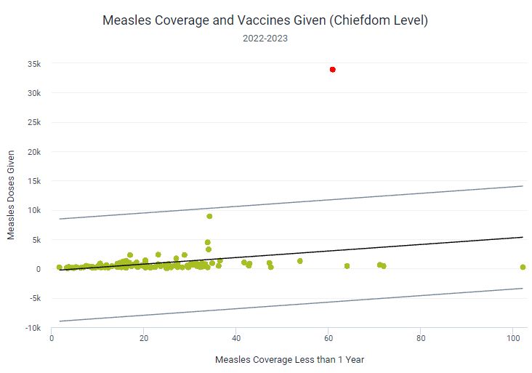
Q6: Chiefdom Level
Shapiro-Wilks Test:
data: Measles_Chiefdom$Coverage
W = 0.85202, p-value = 2.884e-10
data: Measles_Chiefdom$Doses_Given
W = 0.17826, p-value < 2.2e-16
Spearman's Rank Correlation Rho:
data: Measles_Chiefdom$Coverage and Measles_Chiefdom$Doses_Given S = 200495, p-value = 7.7e-10 alternative hypothesis: true rho is not equal to 0 sample estimates: rho 0.500005

Slide 34
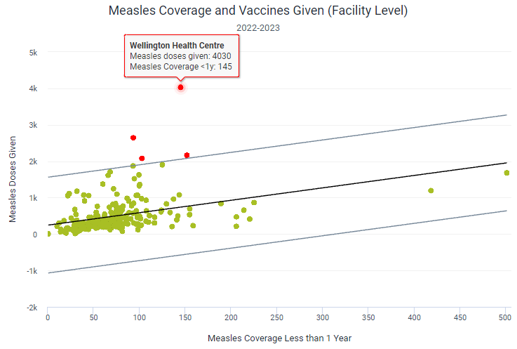
Q6: Facility Level
Shapiro-Wilks Test:
data: Measles_Facility$Coverage W = 0.70002, p-value < 2.2e-16
data: Measles_Facility$Doses_Given W = 0.70558, p-value < 2.2e-16
Spearman's Rank Correlation Rho:
data: Measles_Facility$Coverage and Measles_Facility$Doses_Given S = 996517, p-value = 4.987e-16 alternative hypothesis: true rho is not equal to 0 sample estimates: rho 0.5021047

Slide 35
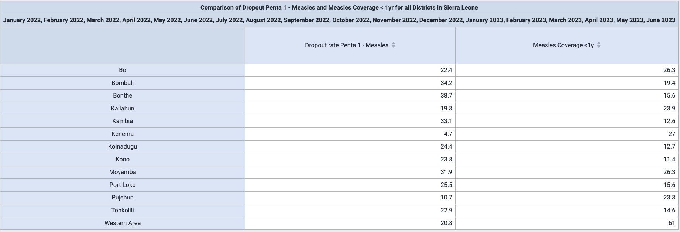
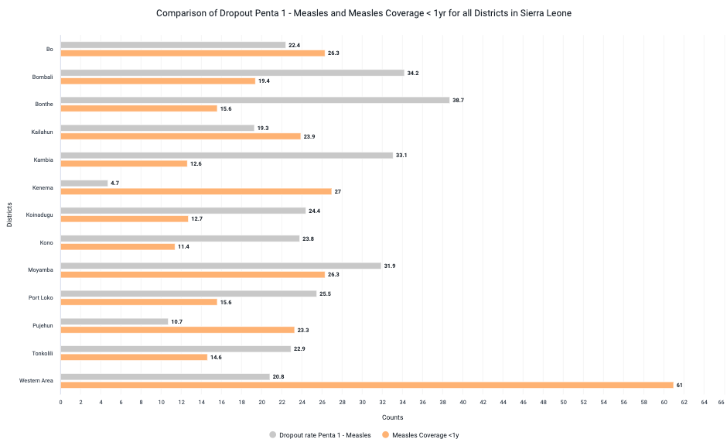
Question 7: Create a bar chart comparing the Dropout Penta 1 -measles and measles coverage < 1y for all the districts in Sierra Leone for 2022 and the first 6 months of 2023. Do you see a correlation between these two indicators? Analyze the correlation and interpret the results.
Steps
Data Visualizer App
Data (Series):
Indicator: Dropout rate Penta 1-Measles
Indicator: Measles Coverage < 1
OrgUnits (Category):
Level = District
Period (Filter):
Monthly From January 2022 to June 2023
Pivot Table generated and downloaded for correlation analysis in R
Notes:
Insert a picture that illustrates some part of your country’s economy.

Slide 36



Q7: Correlation Analysis
Linearity: The scatter plot shows a negative linear trend, suggesting that as the dropout rate for Penta 1 - Measles increases, the measles coverage for children <1 year old tends to decrease.
Normality: The Shapiro-Wilk tests resulted in:
Dropout Rate for Penta 1 – Measles has a p-value > 0.05, indicating a normal distribution
Mealses Coverage for Children < 1yr has a p-value < 0.05, suggesting a departure from a normal distribution
Notes:
Insert a picture that illustrates some part of your country’s economy.

Slide 37

Kendall's Rank Correlation Tau:
The correlation coefficient of -0.3117 denotes a weak negative linear relationship.
The p-value of 0.1416 indicates that the correlation is not statistically significant.
Overall, the analysis suggests there is not a significant correlation between the dropout rate for Penta 1 - Measles and measles coverage in children under one year old for all districts.

Slide 38

Question 8: Describe the location where the districts with the lowest births by skills attendants are performed in Sierra Leone for 2022. Hint: Think about their proximity to the capital city.
Port Loko had the lowest births (50)
Bordering district to the capital
Steps
Data Visualizer App
Data (Series):
Births attended by skilled health personnel (registered live births)
Period (Category):
Yearly in year 2022
OrgUnits (Filter):
Level: District
Open as Map
Choropleth
Classes = 9
Display value labels
Bing Road Layer
Facility Layer
Group set = Facility Type
Measurement tool to approximate distances
Notes:
Insert a picture that illustrates some part of your country’s economy.

Slide 39

Q8: proximity of facilities in port loko to the capital city
Notes:
Insert a picture that illustrates some part of your country’s economy.

Slide 40

Q8: proximity of facilities in port loko to the capital city
Closest MCHP(Lungi Town MCHP) is about 11mi from the capital
Notes:
Insert a picture that illustrates some part of your country’s economy.

Slide 41

Q8: proximity of facilities in port loko to the capital city
Closest CHP (Pepel CHP) is about 14mi from the capital
Notes:
Insert a picture that illustrates some part of your country’s economy.

Slide 42

Q8: proximity of facilities in port loko to the capital city
Furthest CHP (Kantia CHP) is about 73 mi from the capital
Notes:
Insert a picture that illustrates some part of your country’s economy.

Slide 43


Question 9: Create a new dashboard of the charts/maps/tables

Slide 44



Slide 45



Slide 46

Link to the dhis2 Dashboard- http://b585.info:8080/dhis-web-dashboard/#/titQPfPZVgD

Slide 47
Question 10: Describe any three validation rules that are appropriate to validate data that you have used in your analysis. What are some of the quality issues with the data that you used for your analysis?
Data Validation Rules
Rule Definition: Ensure that the count of ANC IPT2 (the second dose of Intermittent Preventive Treatment) is never greater than the count of ANC IPT1 (the first dose) for any given period.
This is because every patient who receives the second dose must have received the first dose, but not everyone who receives the first dose will necessarily receive the second dose (Anchang-Kimbi et al., 2014)
Implementation Logic: For each reporting period (e.g., monthly), compare the recorded number of IPT2 doses administered against the number of IPT1 doses. If the IPT2 count exceeds the IPT1 count, the data should be flagged for review.
2. Rule Definition: Measles coverage for children < 1yr must not exceed 100% and should align with expected coverage rates based on vaccination campaign targets and population demographics for any given period.
3. Rule Definition : Severe malnutrition rates must always be less than or equal to moderate malnutrition rates, and both should be within their respective plausible ranges.
Validate that for any given population group or area, the severe malnutrition rate is never higher than the moderate malnutrition rate.
Flag any data points where severe malnutrition rates exceed moderate rates or fall outside these ranges for review.

Slide 48
Data Quality Issues
Completeness: The missing data for certain facilities like MCHPs (Maternal and Child Health Posts) and CHPs (Community Health Posts) directly impacts the completeness of the dataset. Without full data, the analysis cannot account for all variables and may lead to biased conclusions.
Missing data can lead to inconsistencies when comparing different datasets or time periods. For instance, if data for specific months or facilities is absent, it's challenging to perform consistent trend analysis over time.
Consistency: The expectation for ANC IPT1 and ANC IPT2 data is that the number of individuals who receive the first dose (ANC IPT1) should always be equal to or greater than those who receive the second dose (ANC IPT2). Instances where ANC IPT2 exceeds ANC IPT1 are inconsistent with standard medical protocols, as individuals must receive the first dose before the second. Thus, the data displays an inconsistency, either due to data entry errors, reporting issues, or a misunderstanding of the definitions for each indicator.

Slide 49
References
Anchang-Kimbi, J.K., Achidi, E.A., Apinjoh, T.O. et al. Antenatal care visit attendance, intermittent preventive treatment during pregnancy (IPTp) and malaria parasitaemia at delivery. Malar J 13, 162 (2014). https://doi.org/10.1186/1475-2875-13-162
Babughirana, Geoffrey & Amponsah, Monica & Banura, Evelyn & Egoeh, Seth & Barrie, Mohammed & Kanwagi, Robert. (2018). Assessment of the Readiness of Community Health Workers to Participate in a Mobile Training and Support Services Innovation: Results of a Functionality Assessment in Bo District, Sierra Leone 2018. American Journal of Computer Science and Information Technology. 06. 10.21767/2349-3917.100028.
DHIS2, District Health Information System.

